Slide 1
Privvy
Delhi Hacks 2020
Adarsh Singh, Piyush Verma, Pundreek Saurabh
Shikhar Kwatra and Rosanna Mannan
Data management just became easy!
Notes:
We designed this template so that each member of the project team has a set of slides with its own theme. Members, here’s how you add a new slide to just your set:
Mark where you want to add the slide: Select an existing one in the Thumbnails pane, click the New Slide button, then choose a layout. The new slide gets the same theme as the other slides in your set.
Careful! Don’t annoy your fellow presenters by accidentally changing their themes. That can happen if you choose a different theme from the Design tab, which changes all of the slides in the presentation to that look.

Slide 2
Agenda
Background
Problem Statement
Our Approach
Next Steps
Technical Specifications
Conclusion

Slide 3
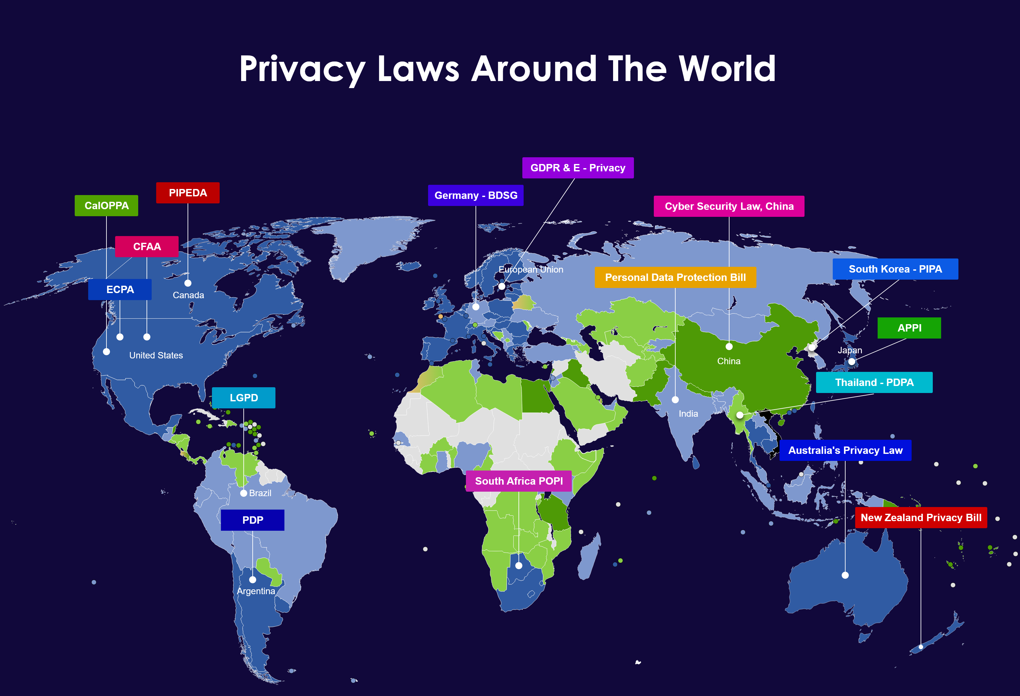
Background
New and increasingly stricter local and national laws, such as GDPR, CCPA, and LGPD, are providing citizens and consumers with privacy rights.
For example, these laws give individuals the choice to consent to cookies and to consent to the selling of their personal information.
Companies collect, process, and manage personal information, but individuals do not have a way to manage their new privacy rights.

Slide 4
Problem Statement
The global data governance market size is expected to grow from USD $2 billion in 2020 to USD 5.7 billionin 2025, at Compound Annual Growth Rate (CAGR) of 22.3% during the forecast period.
The data privacy market is growing exponentially and people want more control over their data.
See https://www.marketsandmarkets.com/Market-Reports/data-governance-market-108243043.html
There are many companies working on detecting if your personal information has been exposed by a data breach. These methods are reactive in nature, because they occur after the personal information is exposed.

Slide 5
Our Approach
Privvy is a data management application that proactively helps individuals exercise their privacy rights.
When a user visits a website, Privvy navigates through the website page to search for the cookie policy. The system then scrapes the cookie policy and extracts relevant information such as the permissions the website is asking for. It shows all the cookies that are active on the particular website.

Slide 6
Next Steps
The intent is to take this idea to the next level by allowing the user to make sure they understand what they are signing up for and for the user to have control over their data privacy rights.
By extracting information from a privacy or cookie policy, the system can prompt the user to take an action, such as consenting to or deleting cookies.

Slide 7
Technical Specifications
Chrome Extension
Google API
Javascript
Python
Node.js
NLP (proposed)

Slide 8
Conclusion
The application will help users manage their privacy rights.
We envision enabling this as a plugin software for users across the globe to manage their data being shared in a more transparent fashion and to have enhanced control over their data.

